Slide 1
Week 9: Animation and Documentary
Notes:
In previous weeks we have focused on different aspect of animation. We have looked at things such as animation and space, animation and sound but this has predominantly been located within the realm of fiction.
This week we are going to focus on non-fiction by focusing on animation and documentary
Long history of hybridization of animation and doc
Animation has been used in non-fictional contexts to illustrate, clarify and emphasise from its early history
animated segments used in non-fiction – Frank Capra’s Why we Fight (1942-5) and Michael Moore’s Bowling for Columbine (2002)
since 90s – increase in the production of moving image texts that are specifically produced as animated documentary.
Waltz with Bashir (Ari Folman, 2008) and Tower (2016)

Slide 2
Neighbours (1952 film)

Slide 3
Aims of today’s session:
Consider what constitutes an animated documentary?
What are the implications of using animation in a non-fiction context?
What issues arise from the use of animation in documentary?

Slide 4
What do you consider to constitute an animated documentary?
Tower (Kevin Maitland, 2016)
Notes:
Let’s begin with a question: What do you consider to constitute an animated documentary? What do the words ‘animated’ and ‘documentary’ conjure up for you?

Slide 5
Taxonomy of Animated Documentary
has been recorded or created frame by frame
is about the world rather than a world wholly imagined by its creator
has been presented as a documentary by its producers and/or received as a documentary by audiences, festivals or critics
Notes:
Honess Roe’s Taxonomy of animated documentary
According to Honess Roe, something can be considered to be an animated documentary if it fulfills the following criteria.
has been recorded or created frame by frame
is about the world rather than a world wholly imagined by its creator
has been presented as a documentary by its producers and/or received as a documentary by audiences, festivals or critics development of the animated documentary as a form in its own right

Slide 6
The Sinking of the Lusitania (Winsor McCay 1918)
https://www.youtube.com/watch?v=0Ugk348jStc
Notes:
As I mentioned at the beginning of this lecture the employment of animation within a non-fiction context stretches back to the early history of animation.
In 1918, animator Winsor Mc Cay created what is generally agreed to be the first animated documentary, The Sinking of the Lusitania
https://www.youtube.com/watch?v=0Ugk348jStc
The sinking of the Lusitania was shocking event but there was a lack of recorded footage of the incident
McCay recreated the events, as retold by survivors, using animation
The film differs from his usual animation style to suit the subject matter
It resembles non-fiction media of the time – newsreels, newspaper illustrations
Interestingly it begins with a live-action prologue with McCay and his collegues working on the film’s images
McCay makes no distinction between live-action and animation in terms of their ability to show us reality
It demonstrates an early use of animation as a substitute for missing live-action material
https://www.youtube.com/watch?v=zvXdp6HRXQs

Slide 7
Fight for the Dardanelles (1915) Percy Smith
Notes:
Animation has historically been used as a tool of illustration and clarification in factual films.
For example, in 1915 Percy Smith was commissioned to make a series of short films such as Fight for the Dardanelles (1915) to depict battles of the first world war
In the US Max Fleischer was creating animated films for the military as early as 1917 in order to train soldiers heading to battle in Europe
The NFBC – commissioned Disney to make films to promote the Canadian war effort
Subsequently the US government commissioned Disney to make numerous educational and training films during the war
Disney provided the animated sections for Frank Capra’s Why We Fight series of films – animated maps, illustrations of military equipment, diagrams – military strategy
As Honess Roe points out ‘This use of animation demonstrates that envisioned information is easier to understand and retain, and that much factual information is communicated more efficiently via animation than the spoken word’ (8)

Slide 8
Prelude to War (1942) Frank Capra (from the Why We Fight series)
Notes:
These films conveyed more than facts through their use of animation – symbolism, visual association, colour
Prelude to War 1942 – black inky stain spreads across Japan, Italy and Germany

Slide 9
Animation is often use to to ‘clarify, explain, illustrate and emphasise’ (Honess Roe, 2013,
: 9)
Wonders of the Solar System (BBC, 2010)
A is for Atom (Carl Urbano, 1953)
Notes:
Animation is employed in many contemporary documentaries to ‘clarify, explain, illustrate and emphasise’’( 9)
‘This illustrative function of animation has become commonplace to the point of being inconspicuous’
Natural history, science and history programming now use digital animation as a matter of course to bring to life objects and events that are impossible to capture with the live-action camera.
BBC Wonders of the Solar System 2010 – displays CGI close-ups of far-off planets that would be impossible to film or photograph https://www.youtube.com/watch?v=NUfd7RLMScU
John Sutherland Studios A is for Atom (1953) educates audiences about nuclear energy and its use during peacetime, something that at the time of its production was not possible to photograph https://www.youtube.com/watch?v=Gi-ItrJISQE
seen by over seven million people in this version and a shortened ten-minute theatrical cut.
Can be use for ‘ironic interjection’ Bowling for Columbine or even a sit-com like Black-ish in which the cartoonlike styles can contrast with serious ideas.
’Dre’s history lesson: Blackish’ https://www.youtube.com/watch?v=BJMlax1cuTA
‘I am a Slave’: Blackish https://www.youtube.com/watch?v=M_FP7x322cc
https://www.youtube.com/watch?v=KKm2n82CpQ4
https://www.youtube.com/watch?v=BJMlax1cuTA

Slide 10
A Is For Autism (1992) Tim Webb
https://www.youtube.com/watch?v=zxt3FBVq8Jg
Notes:
Animated documentaries can also reveal subjective, conscious experience via animation that is evocative rather that directly representational. It can encourage us to imagine from our own point of view and ‘empathise with the unfamiliar experiences of other people.’ (15)
https://www.youtube.com/watch?v=zxt3FBVq8Jg

Slide 11
Waltz with Bashir (2008) Ari Folman
Notes:
Further to this animated documentaries can also be used as an archeological tool for exploring one’s own past. They can be a ‘…means of accessing the now absent past, especially pasts from which the filmmakers have been ruptured due to trauma or other events that cause a disruption in the continuity of personal and collective memory.’ 16
For example, Ari Folman's animated documentary Waltz with Bashir into the horrors of the 1982 Lebanon war manifests his personal memories of the war through a first person narrative.
Play clip: https://learningonscreen.ac.uk/ondemand/index.php/clip/146554
https://www.youtube.com/watch?v=YurHqWm6C8E

Slide 12
Some questions to consider
What are the implications of the use of animation as a representational strategy in documentary
Consider the ways that animation is used in animated documentary
What and how is the animation representing?
How and why is animation being used instead of the conventional alternative?
Notes:
Watch the beginning from Tower (2016)

Slide 13
‘Animation, in part through its material differences from live-action film, shifts and broadens the limits of what and how we can show about reality by offering new or alternative ways of seeing the world. It can present the conventional subject matter of documentary (the ‘world out there’ of observable events) in non-conventional subjective, conscious experience – subject matters traditionally outside of the documentary purview’ (Annabelle Honess Roe, 2013: 1)
Notes:
Although animation might seem to threaten the documentary form by ‘destabilising its claim to represent reality, Annabelle Honess Roes suggests the the opposite to be the case:
‘Animation, in part through its material differences from live-action film, shifts and broadens the limits of what and how we can show about reality by offering new or alternative ways of seeing the world. It can present the conventional subject matter of documentary (the ‘world out there’ of observable events) in non-conventional subjective, conscious experience – subject matters traditionally outside of the documentary purview’ (Annabelle Honess Roe, 2013: 1)
But further to this, it can ‘conflate history, transcend geography and give insight into the mental states of other people.’ It can demonstrate subjective experience.

Slide 14
Question
‘There is little question that animated documentaries are animated films, whereas there is potential debate as to whether animation is a acceptable mode of representation for documentary’ (Honess-Roe, 3
Do you think that animation is an acceptable mode of representation for documentary? Why?
Notes:
‘There is little question that animated documentaries are animated films, whereas there is potential debate as to whether animation is a acceptable mode of representation for documentary.’ 3
Do you think that animation is an acceptable mode of representation for documentary? Why?
Watch the beginning from Tower (2016)

Slide 15
Authenticity
In his book Blurred Boundaries, documentary theorist Bill Nichols writes that the the documentary ‘is depended on the specificity of its images for authenticity’ (1994: 29).
The authenticity of a documentary is ‘deeply linked to notions of realism and the idea that documentary images bear linked to notions of realism and the idea that documentary images bear evidence of events that actually happened, by virtue of the indexical relationship between image and reality’ (Honess Roe 2013, 3)
Notes:
In his book Blurred Boundaries, documentary theorist Bill Nichols writes that the the documentary ‘is depended on the specificity of its images for authenticity’ (1994: 29).
As Honess Roe points out the authenticity of a documentary is ‘deeply linked to notions of realism and the idea that documentary images bear linked to notions of realism and the idea that documentary images bear evidence of events that actually happened, by virtue of the indexical relationship between image and reality (Honess Roe 2013, 3). As she further points out however, animation, ‘presents problems for this documentary ontology and this means that animated documentaries do not fit easily into the received wisdom of what a documentary is’ (3).

Slide 16
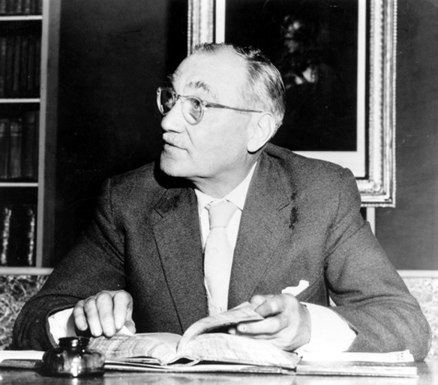
John Grierson famously refers to documentary ‘as the creative treatment of actuality’ (1933: 8)
Could we view Nichols and Grierson as helping us to think of animation as a viable means of documentary expression.
Notes:
John Grierson, often referred to the father of animation infamously refers to documentary ‘as the creative treatment of actuality’ (1933: 8)
Could we view Nichols and Grierson as helping us to think of animation as a viable means of documentary expression.

Slide 17
Question
Do you think that all non-fiction work that contains animation can be considered to be an animated documentary? Why/Why not?
Chicago 10 (Brett Morgen, 2007

Slide 18
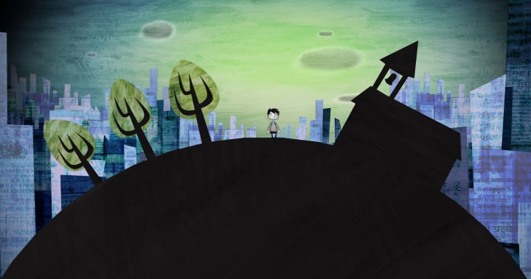
The animation and documentary should cohere into a single form ‘in which the animation works to enhance our knowledge of an aspect of the world and to the extent that the separation of the animation from the documentary is either impossible, or would render the inherent meaning of the film incomprehensible’ (Honess Roe, 2013: 10)
Notes:
Not all moving image texts that use animation can be considered to be animated documentaries even if they are ostensibly documentaries. The animation and documentary should cohere into a single form ‘in which the animation works to enhance our knowledge of an aspect of the world and to the extent that the separation of the animation from the documentary is either impossible, or would render the inherent meaning of the film incomprehensible’ (Honess Roe: 10). With the exception of The Sinking of Lusitania few historical documentaries which employ animation do this.
The propaganda message of Why We Fight would still be conveyed without animation
However, recent work such as Waltz with Bashir have ‘animation embedded into their very core’, the first person accounts of mental health issues in the Animated Minds television series commissioned by Channel 4 are more than just radio documentaries.
‘The animation adds something very specific to the way we interpret and understand the experiences being recounted’ (10)
The BBC television series Walking with Dinosaurs ‘depends on it realistic animated reconstructions of prehistoric life, in a style that copies the familiar aesethetic of the way dinosaurs lived (11)

Slide 19
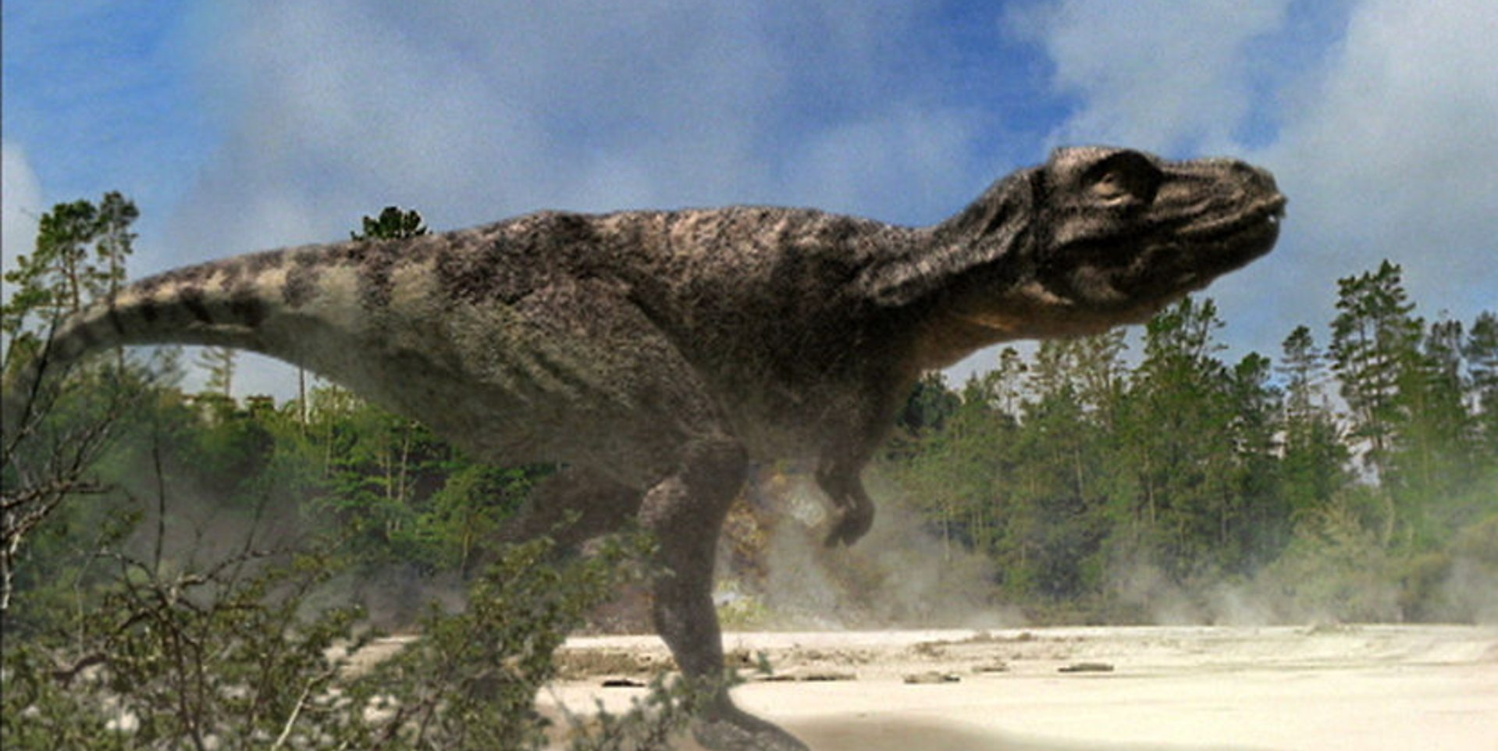
‘…animation is a fruitful means of documentary representation in part because it creates a conflation of absence and excess. That is, the expected indexical imagery of documentary is absent, and in its place is animation, which can take multiple different forms, all with a materiality, aesthetics, and style that goes above and beyond merely ‘transcribing ‘ reality (a quality David Rodowick (2007) suggests is characteristic of the photography) (14)
Notes:
Honess Roe suggests that ‘animation is a fruitful means of documentary representation in part because it creates a conflation of absence and excess. That is, the expected indexical imagery of documentary is absent, and in its place is animation, which can take multiple different forms, all with a materiality, aesthetics, and style that goes above and beyond merely ‘transcribing ‘ reality (a quality David Rodowick (2007) suggests is characteristic of the photography) (14)
The BBC television series Walking with Dinosaurs ‘depends on it realistic animated reconstructions of prehistoric life, in a style that copies the familiar aesethetic of the way dinosaurs lived (11). It adopts the tropes of history documentaries and through conventional and didactic voiceover narration but it also uses digital animation to reconstruct historic and contemporary events – mimics the look of reality and photoreality.

Slide 20
Issues
Bella Honess Roe writes that some authors have taken issue with the use of the term ‘documentary’ in relation to ‘animated documentaries’ (Honess Roe, 2016: 20).
Why do you think this might be?
I Met the Walrus (Josh Raskin, 2007)
Notes:
Bella Honess Roe writes that some authors have taken issue with the use of the term ‘documentary’ in relation to ‘animated documentaries’. (Honess Roe, 2016: 20)
Reception to Animated Documentary remains positive in the wake of the publication of Honess Roe’s 2013 book Animated Documentary.
https://vimeo.com/11661493

Slide 21
Issues Around Definitions
“animated documentaries do not easily into the received wisdom of what a documentary is” (Honess Roe, 2013: 3).
Christina Formenti locates it in the realm of docu-fiction due to what she perceives as the lack of objectivity of what we observe on screen (2014: 108-110)
Notes:
“animated documentaries do not easily into the received wisdom of what a documentary is” (Honess Roe, 2013, p. 3).
In a 2014 article Christina Formenti asserts that due to the “necessity of justifying the animated documentary’s allocation within the documentary realm” (p. 103Christina Formenti locates it in the realm of docu-fiction to do what she perceives as the lack of objectivity of what we observe on screen and the need to justify the animated documentaries position within a documentary tradition (2014: 108-110)
This ehoes the responses of other theorists such as Paul Wells who claims that ‘the very subjectivity involved in producing animation […] means that any aspiration towards suggesting reality in animation becomes difficult to execute. For example, the intention to create “documentary” in animation is inhibited by the fact that the medium cannot be objective.’ At its best, animation can show a documentary tendency, by mimicking the conventions of live-action documentary film and engaging with social reality (Wells 1998: 27-28).
However, Honess Roe points out ‘… animation does not fit in their preconceived notion of what a documentary should look like and the relationship between what they expect to see on screen and what (supposedly happened in reality.’ 22. For these animated documentaries are not documentary enough. This attitude is rooted in the widely held assumptions that “documentaries should be observational, unobtrusive, truthful, bear witness to actual events, contain interviews and, even, be objective.” (p. 3)
Do you consider this Is this view to be outmoded or unrealistic?
Remember John Grierson’s 1933 definition of documentary as “the creative treatment of actuality”
Do you think that the assumption regarding what a documentary should look like have changed and evolved over the years? If so, how?

Slide 22
Two issues that critics repeatedly cite:
audience response:: ‘the concern that animation is a “layer” that prevents the audience from directly engaging with the participants or story of an animated documentary (or, as it is sometimes expressed, “reality”)’ (Honess Roe, 2016: 23)
Montage of Heck (Brett Morgan, 2016)
Notes:
two issues that critics repeatedly, if not overly frequently, express regarding animated documentary.
audience response: ‘the concern that animation is a “layer” that prevents the audience from directly engaging with the participants or story of an animated documentary (or, as it is sometimes expressed, “reality”)’ (Honess Roe, 2016: 23)

Slide 23
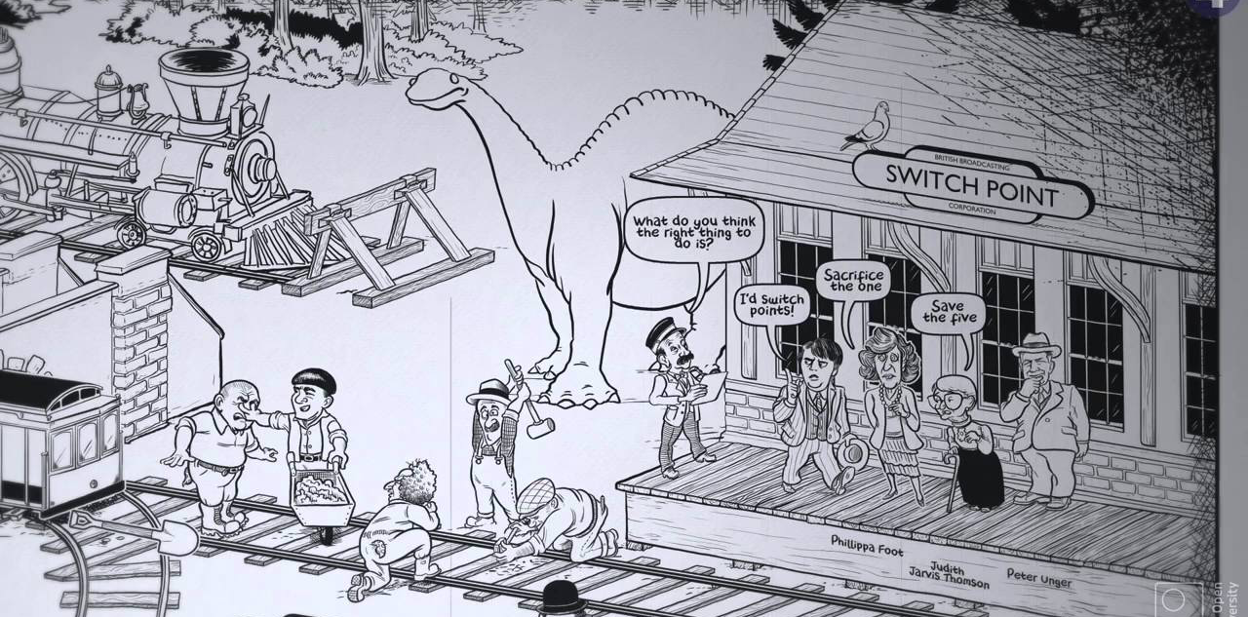
Two issues that critics repeatedly cite:
Technical proficiency: animation bolted onto an existing soundtrack
Notes:
Technical proficiency
It is no longer unusual to see reality animated.
There is a concern that animation becomes more commonplace in documentary it could potentially lead to laziness and is often simply bolted onto an existing animated soundtrack so that the ‘animated documentary’ becomes in effect an illustrated radio documentary. (animations for the BBC’s History of Ideas)
https://www.youtube.com/playlist?list=PLLiykcLllCgPE0q9BiMexLFj-1rq9GUwX

Slide 24
Recap of Session:
We considered what an animated documentary might be considered to be.
We reflected on the implications of using animation in a non-fiction context
We noted some issues that might arise from the use of animation in documentary

Slide 25
Questions to consider
Could animated documentary potentially detract from the seriousness of the situation?
Could it prevent a direct engagement with the factual content of an animated documentary?
Could this be positive?
There is a historical attitude that animation is for children and is not suited to grown up material? How far do you agree/disagree with this?
Could it lead to a more universal level of identification? Why do you think this might be?
Notes:
Could animated documentary potentially detract from the seriousness of the situation?
Could it prevent a direct engagement with the factual content of an animated documentary?
Could this be positive?
There is a historical attitude that animation is for children and is not suited to grown up material? How far do you agree/disagree with this?
Could it lead to a more universal level of identification? Why do you think this might be?

