Slide 1
Design for Animation, narrative structure and film language

Slide 2
Todays topics
What is visual culture
Visual metaphor
Asthetics
Colour in film
Rhythm

Slide 3
What is visual culture
Visual culture is the aspect of culture expressed in visual images.
What does this mean to you?
How can we use this when creating animations?

Slide 4
Visual metaphor
https://www.youtube.com/watch?v=2qYXoJtuzZg

Slide 5
Aesthetics
What are aesthetics?
How do we use aesthetics in films, tv, games and animation?
Further areas……

Slide 6
Colour in film

Slide 7
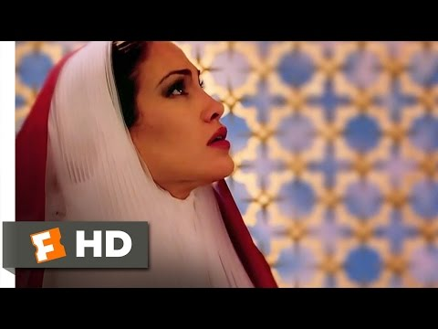
The Cell (2000) -
Tarsem Singh

Slide 8
https://www.youtube.com/watch?v=2ZfaE4HIsjU
https://www.youtube.com/watch?v=MreNB4cH3Rk

Slide 9
Rhythm

Slide 10
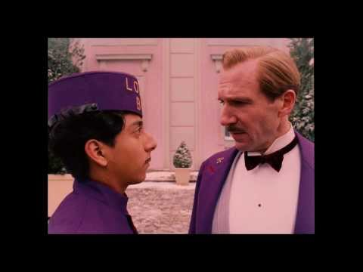
The Grand Budapest Hotel (2014) -
Wes Anderson

Slide 11
https://www.youtube.com/watch?v=jjVOQkN0iXY
https://www.youtube.com/watch?v=W460QxYQgh4

Slide 12
B log post task
For this session I would like you to do a post on visual culture explaining how the following fall in to it:
-mise-en-scene
-visual metaphor
-Asthetics
-colour composition
-rhythm

